Slide 1
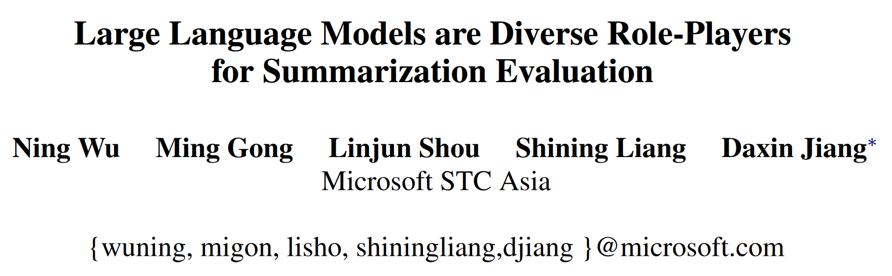
arxiv 2303.15078

Slide 2
Abstract
Task: Text summarization evaluation.
Challenge: Unlike human evaluation, existing automatic metrics cannot measure the quality in multiple dimensions, e.g. grammatical and semantic correctness, comprehensiveness, interestingness, ...
Proposal: Ask LLMs for metrics in each dimension by roleplayer prompting.
Experiments: Highly competitive and highly consistent with human annotators on 2 real summarization datasets.

Slide 3
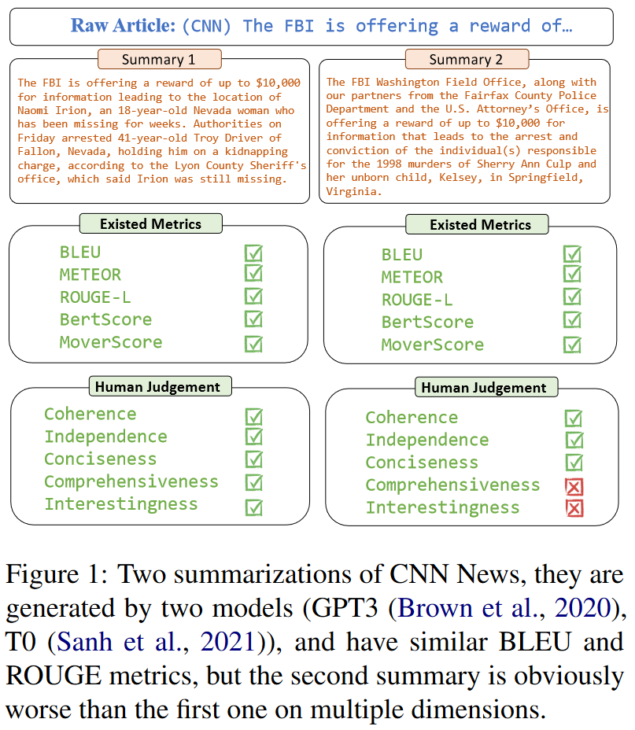
Motivation
When quality is high enough, typical metrics cannot represent real text quality.
Existing automatic metrics cannot capture specific dimensions that human cares, like coherence, grammar, interestingness, ...
How to bridge this gap?
We want to explore how to utilize LLMs to conduct measurement in this paper.

Slide 4
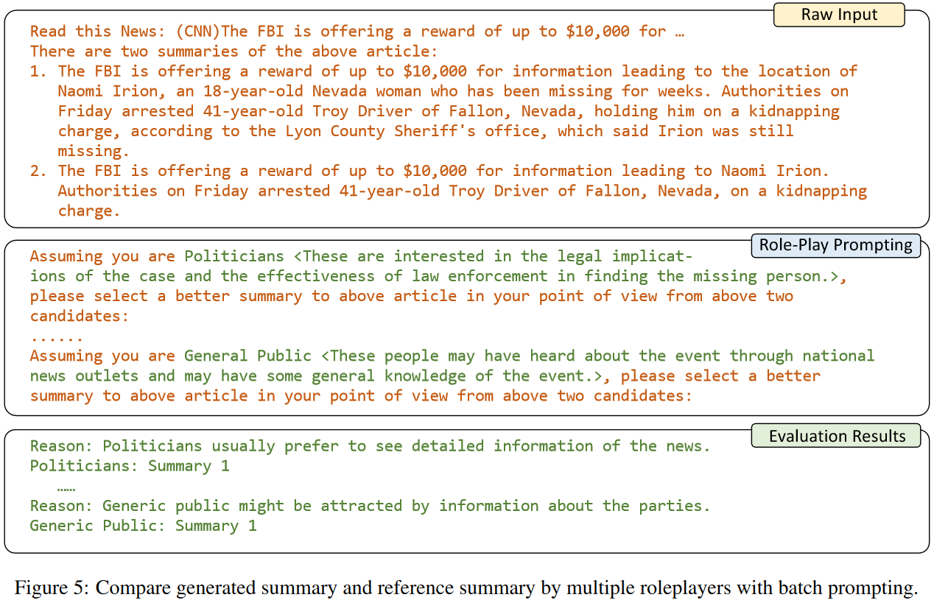
RolePlayer-based Evaluation

Slide 5
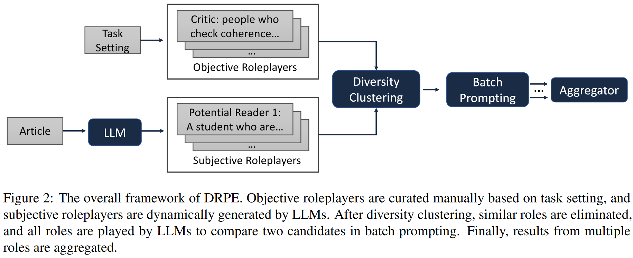
Methodology
We decompose this task into objective and subjective dimensions.
We ask the LLM to act as a judge with a distinctive role to evaluate the text quality in a corresponding dimension and generate the result.

Slide 6
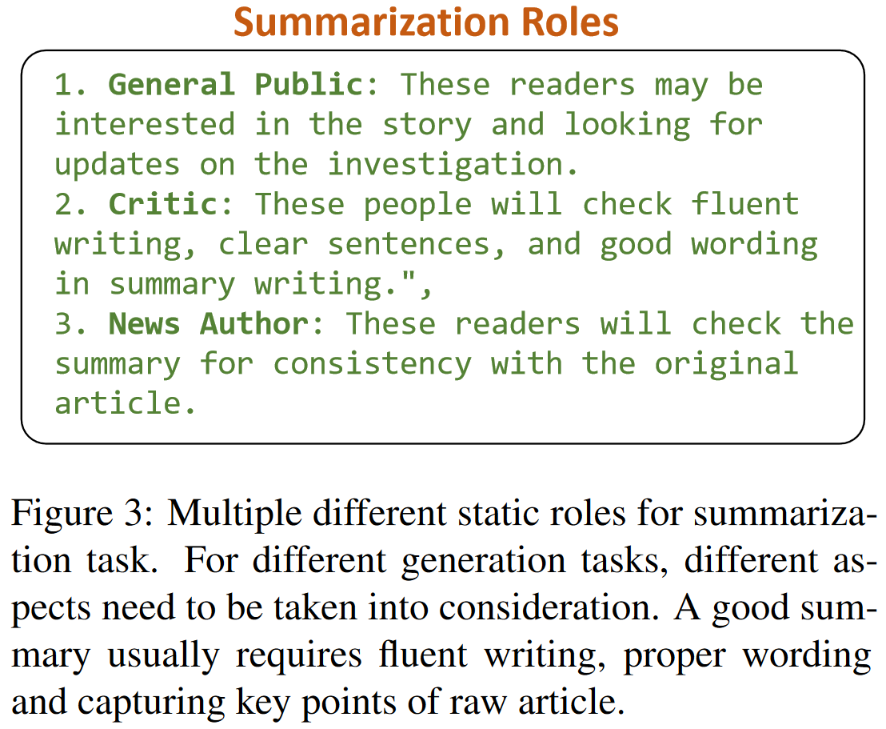
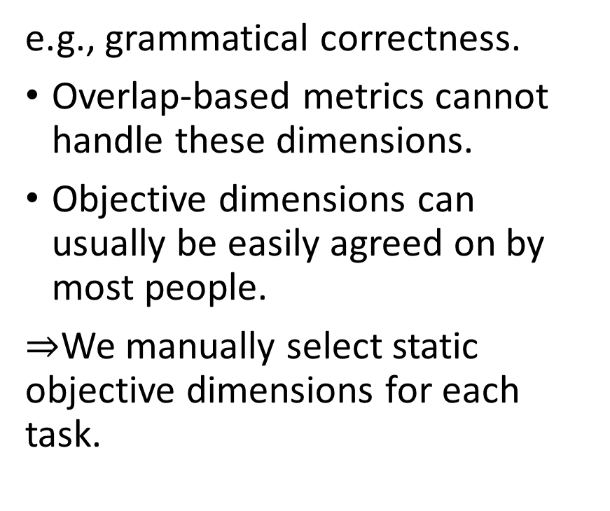
Objective RolePlayers
e.g., grammatical correctness.
Overlap-based metrics cannot handle these dimensions.
Objective dimensions can usually be easily agreed on by most people.
$⇒$We manually select static objective dimensions for each task.

Slide 7
Subjective RolePlayers
Different readers would evaluate the text from their own standpoint.
Example: sports news about a famous sport player in a match.
Writing style & ordinary reader: concise and easy to understand.
Writing style & journalist: structure and choices of words.
Content & causal fans: comprehensive data and horizontal comparison.
Content & die-hard fans: in-depth analysis through data.
We propose to collect subjective evaluations from diverse user perspectives.

Slide 8
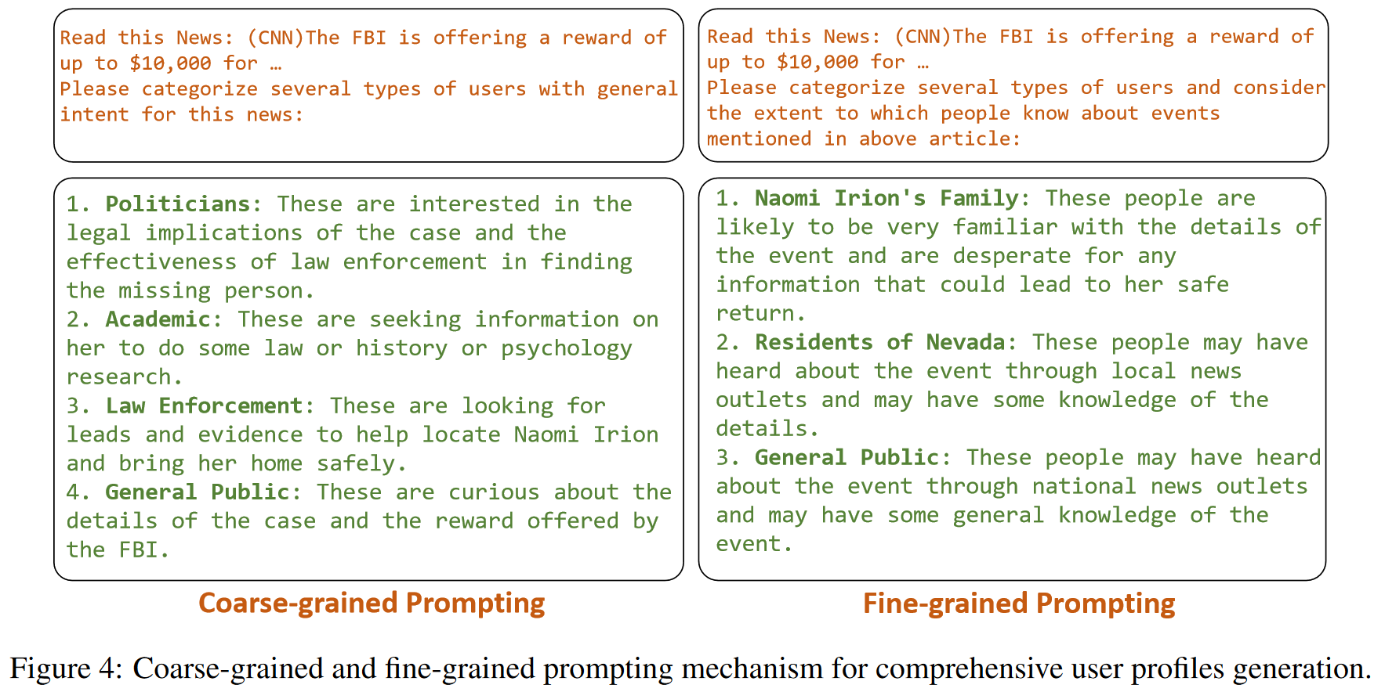
Subjective RolePlayers

Slide 9
Diversity clustering
We merge role players that are too similar:
Concatenate roleplayer type and description.
Put that into SentenceBERT for their representation.
Use DBSCAN algorithm to cluster roleplayers.
Only keep roleplayers closest to each cluster center.

Slide 10
RolePlayer-based Evaluation

Slide 11
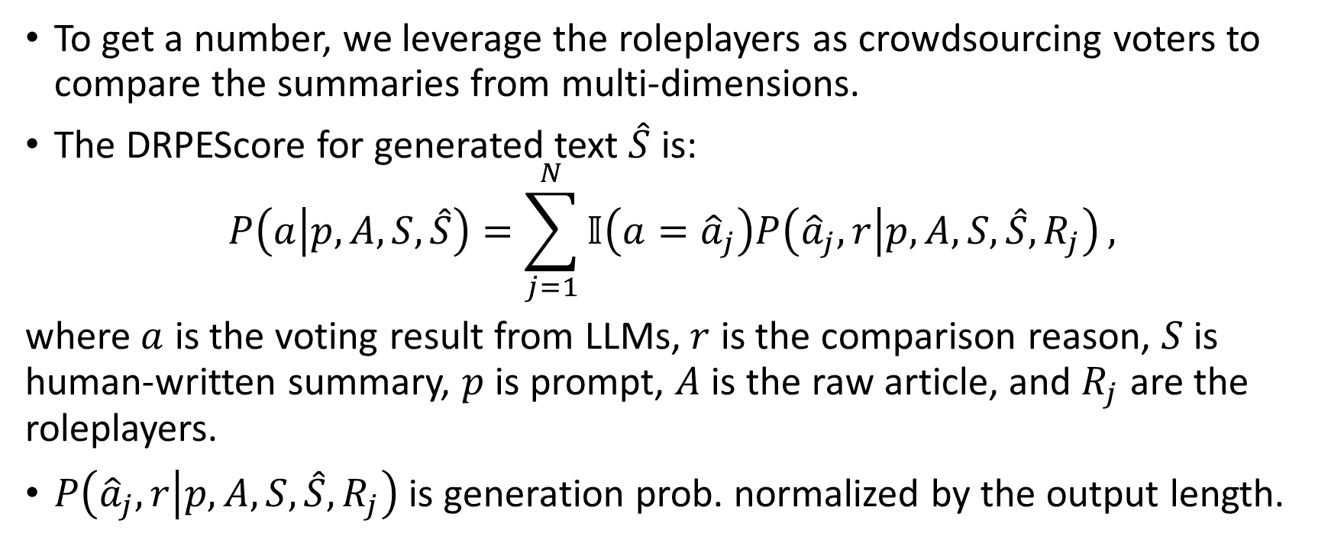
RolePlayer-based Evaluation (in batch)
To get a number, we leverage the roleplayers as crowdsourcing voters to compare the summaries from multi-dimensions.
The DRPEScore for generated text $\hat{S}$ is:
$$P\left(a | p, A, S, \hat{S}\right)=\sum_{j=1}^{N}{𝕀\left(a={\hat{a}}_{j}\right)P\left({\hat{a}}_{j}, r | p, A, S, \hat{S}, R_{j}\right)},$$
where $a$ is the voting result from LLMs, $r$ is the comparison reason, $S$ is human-written summary, $p$ is prompt, $A$ is the raw article, and $R_{j}$ are the roleplayers.
$P\left({\hat{a}}_{j}, r | p, A, S, \hat{S}, R_{j}\right)$ is generation prob. normalized by the output length.

Slide 12
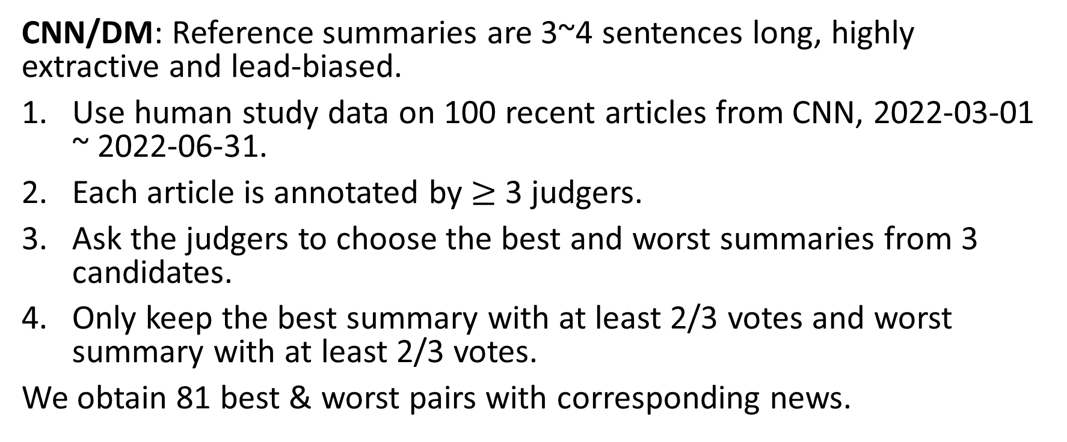
Experiments Settings - Datasets
CNN/DM: Reference summaries are 3~4 sentences long, highly extractive and lead-biased.
Use human study data on 100 recent articles from CNN, 2022-03-01 ~ 2022-06-31.
Each article is annotated by $≥$ 3 judgers.
Ask the judgers to choose the best and worst summaries from 3 candidates.
Only keep the best summary with at least 2/3 votes and worst summary with at least 2/3 votes.
We obtain 81 best & worst pairs with corresponding news.

Slide 13
Experiments Settings - Datasets
XSum: Reference summaries is 1 sentence long, highly abstractive.
Use human study data on 100 recent articles from BBC, 2022-03-01 ~ 2022-06-31.
Take similar preprocessing strategy on this dataset.

Slide 14
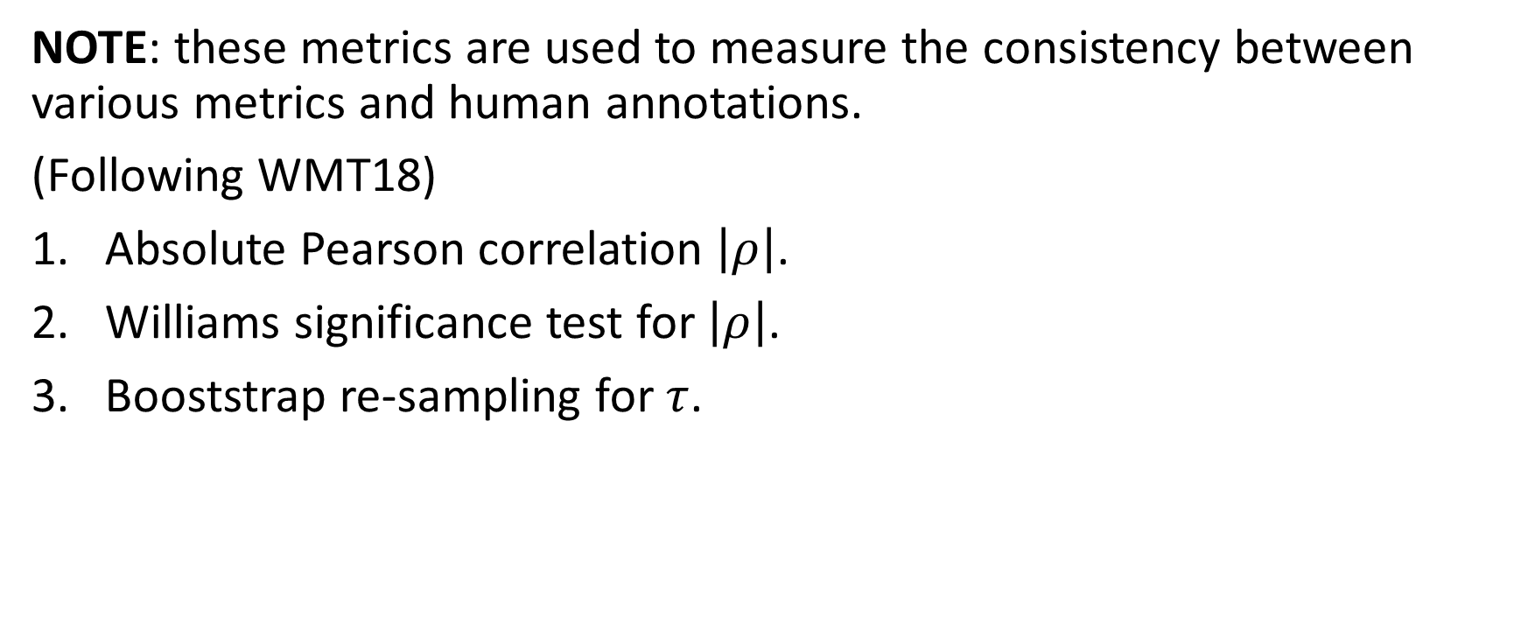
Experiments Settings - Metrics
NOTE: these metrics are used to measure the consistency between various metrics and human annotations.
(Following WMT18)
Absolute Pearson correlation $\left|ρ\right|$.
Williams significance test for $\left|ρ\right|$.
Booststrap re-sampling for $τ$.

Slide 15
Experiments Settings - Baselines
Overlap-based metrics: ROUGE, METEOR, and BLEU.
Similarity-based metrics: BERTScore and MoverScore.
Manual baseline based on LLM:
LLMScore: design a prompt, and ask the LLM to directly predict the better message.
ManualDRPEScore: roles are fixed: students, business man, politician, general public, critic, news author.

Slide 16
Experiments Settings - Implementation
Text-davinci-003 (GPT-3) (one of OpenAI's GPT-3.5 series).
Greedy decoding: temperature is 0.
Objective roles: general public, critic, and news author.
Dynamic roles: 5 roles for each case.

Slide 17
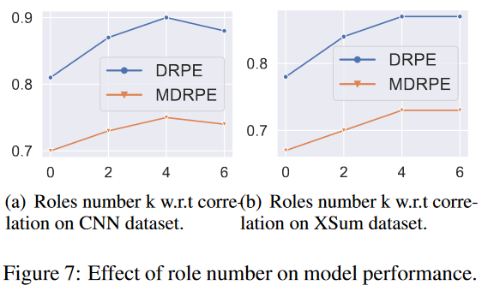
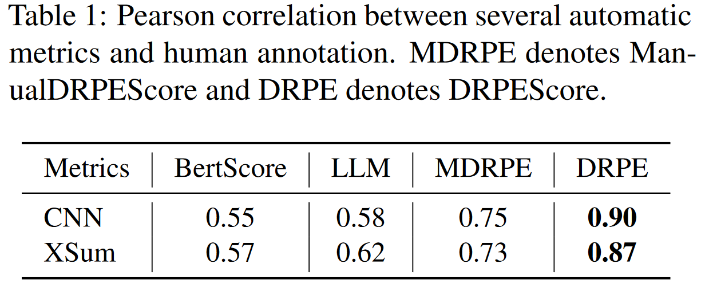
Experimental results

Slide 18
Case Study

Slide 19
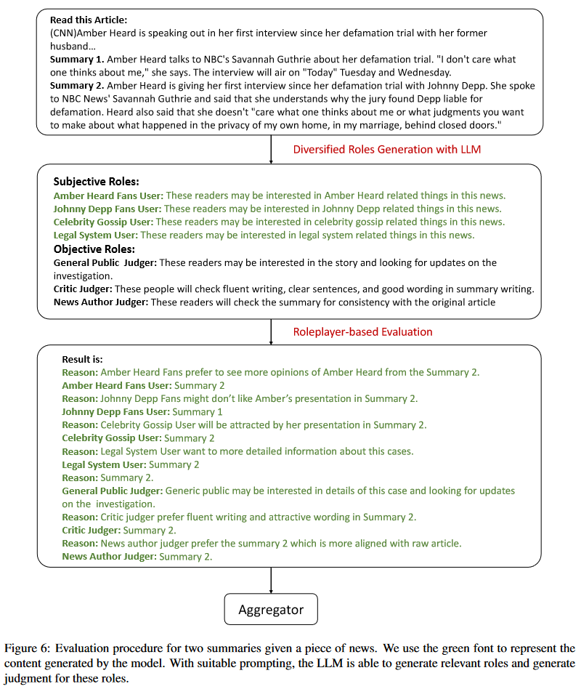

Slide 20
Conclusion & my own thoughts
Interesting problem! Can we use LLMs to simulate (or even replace) human evaluation?
Why I want to talk about this paper?
Can we duplicate similar work in code evaluation? We can use popular metrics in human evaluation, like readability, maintainability, etc. to compose a new metric.
How can a model evaluate its own result?!!
可能类似“模型为什么能给自己纠错” 。
我认为前后两个过程中大模型扮演的是不同的角色，因而发挥了不同的能力。

Slide 21
My own thoughts
它为什么不会倾向于给自己生成的结果打高分？
这个研究里没有试图给大模型生成的结果打分，回避了这个问题。
我认为人主动地给自己的结果打高分可能是因为人能回想起来哪个是自己写的，然后给自己写的那个打高分。
但大模型无法识别哪个是自己写的，因此不会直接偏袒自己。
但它肯定会perfer它自己的风格？
很难反驳这一点。我觉得这篇文章给出了比较好的prompt来规避这种直接比较的情况（通过设立不同的角色），但可能也不太能完全回避。

